Slide 1
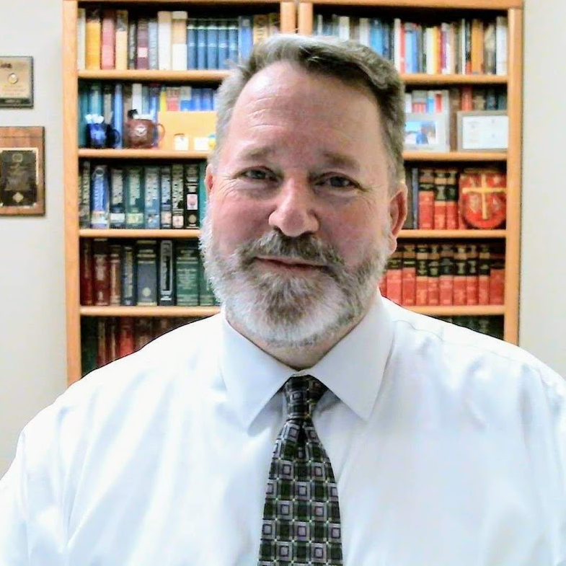
Andrew Hill, J.D. . Associate Professor of Philosophy
St. Philip’s College
San Antonio, Texas

Slide 2
Andrew Hill, J.D.
Andrew Hill, J.D. Administrative/Student Affairs
Andrew Hill, J.D.
Teaching/Academic Affairs
Andrew Hill, J.D.
Degrees/Diploma

Slide 3
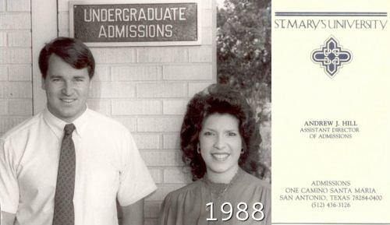
Andrew Hill, J.D. Administrative/Student Affairs
Assistant Director of Admissions Office of Admissions St. Mary's University San Antonio, Texas 1988 - 1990

Slide 4
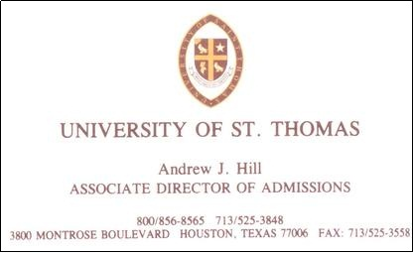
Andrew Hill, J.D. Administrative/Student Affairs
Associate Director of Admissions Office of Admissions University of St. Thomas Houston, Texas 1992 - 1993
Assistant Director of Admissions Office of Admissions St. Mary's University San Antonio, Texas 1988 - 1990

Slide 5
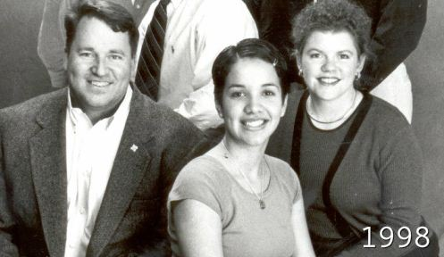
Andrew Hill, J.D. Administrative/Student Affairs
Associate Dean of Students Student Life Office St. Mary's University San Antonio, Texas 1997 - 2001
Associate Director of Admissions Office of Admissions University of St. Thomas Houston, Texas 1992 - 1993
Assistant Director of Admissions Office of Admissions St. Mary's University San Antonio, Texas 1988 - 1990

Slide 6
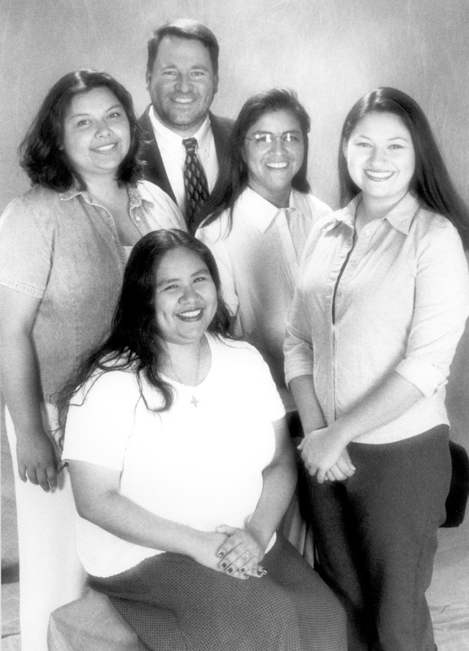
Andrew Hill, J.D. Administrative/Student Affairs
Associate Director Service Learning Center St. Mary's University San Antonio, Texas 2001 - 2002
Associate Dean of Students Student Life Office St. Mary's University San Antonio, Texas 1997 - 2001
Associate Director of Admissions Office of Admissions University of St. Thomas Houston, Texas 1992 - 1993
Assistant Director of Admissions Office of Admissions St. Mary's University San Antonio, Texas 1988 - 1990

Slide 7
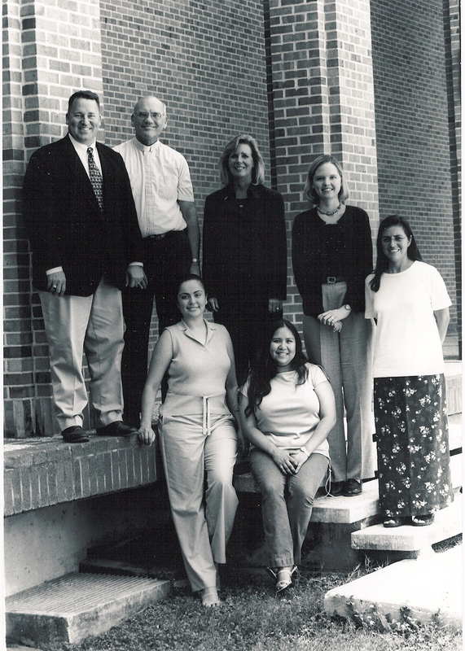
Andrew Hill, J.D. Administrative/Student Affairs
Interim Director Service Learning Center St. Mary's University San Antonio, Texas 2002 - 2003
Associate Director Service Learning Center St. Mary's University San Antonio, Texas 2001 - 2002
Associate Dean of Students Student Life Office St. Mary's University San Antonio, Texas 1997 - 2001
Associate Director of Admissions Office of Admissions University of St. Thomas Houston, Texas 1992 - 1993
Assistant Director of Admissions Office of Admissions St. Mary's University San Antonio, Texas 1988 - 1990

Slide 8
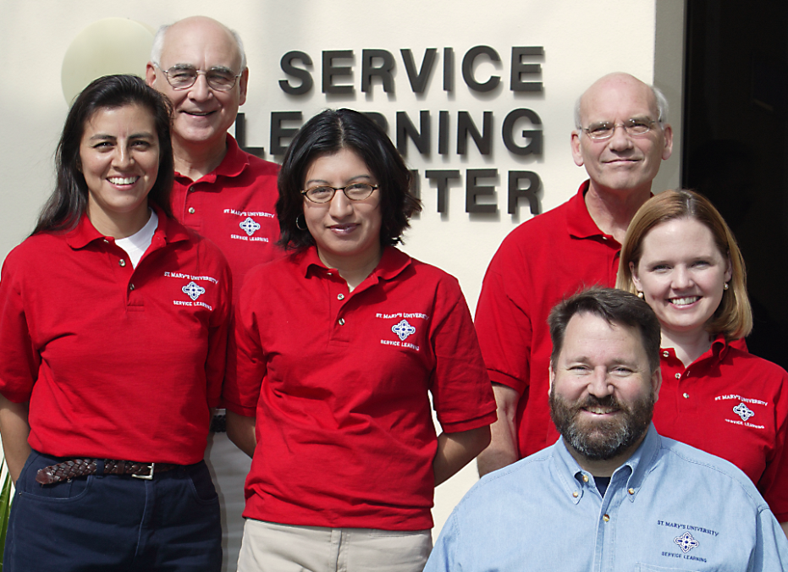
Andrew Hill, J.D. Administrative/Student Affairs
Director Service Learning Center St. Mary's University San Antonio, Texas 2003 - 2006
Interim Director Service Learning Center St. Mary's University San Antonio, Texas 2002 - 2003
Associate Director Service Learning Center St. Mary's University San Antonio, Texas 2001 - 2002
Associate Dean of Students Student Life Office St. Mary's University San Antonio, Texas 1997 - 2001
Associate Director of Admissions Office of Admissions University of St. Thomas Houston, Texas 1992 - 1993
Assistant Director of Admissions Office of Admissions St. Mary's University San Antonio, Texas 1988 - 1990

Slide 9
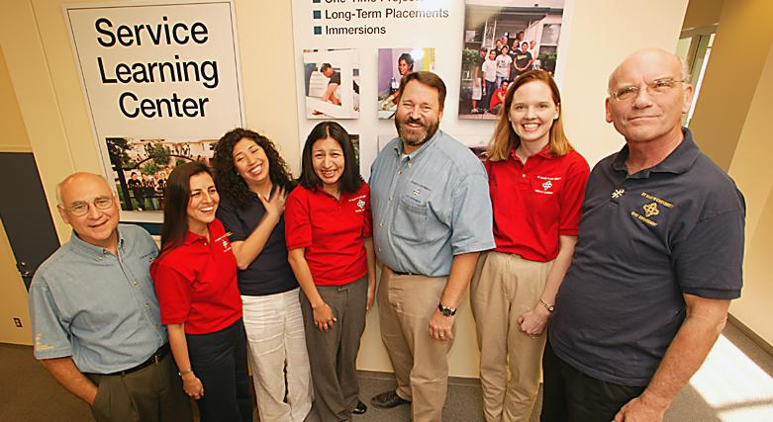
I led the Service Learning Center at
St. Mary’s University for four years (2002 – 2006), and gained valuable experience with budgets and supervision of the professional staff.

Slide 10
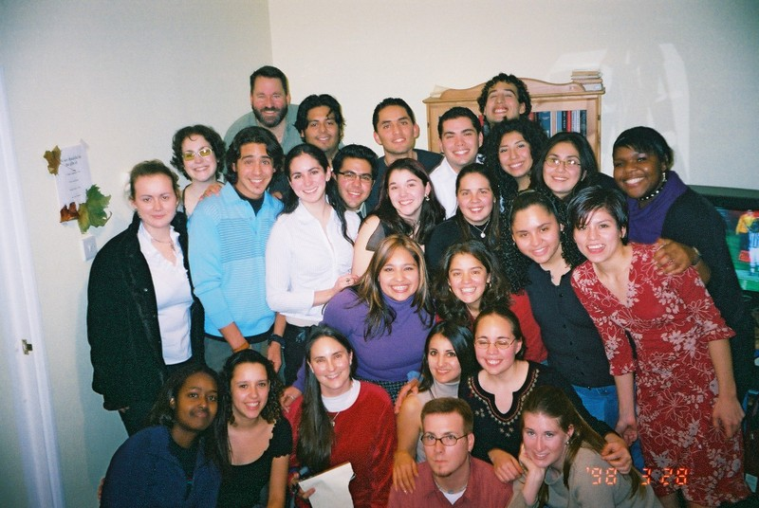
Andrew Hill, J.D. Teaching/Academic Affairs
Lecturer, Law & Ethics Graduate School St. Mary's University, San Antonio, Texas 1998 - 2003

Slide 11
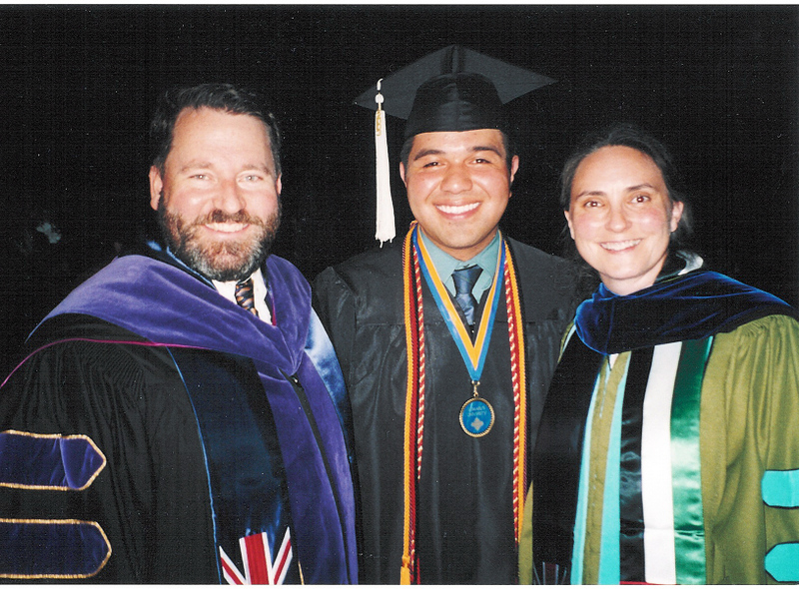
Andrew Hill, J.D. Teaching/Academic Affairs
Senior Lecturer, Law & Ethics Graduate School St. Mary's University, San Antonio, Texas 2003 - 2006
Lecturer, Law & Ethics Graduate School St. Mary's University, San Antonio, Texas 1998 - 2003

Slide 12
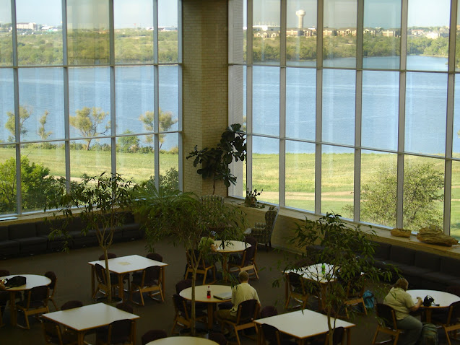
Andrew Hill, J.D. Teaching/Academic Affairs
Adjunct Instructor, Philosophy Humanities Division Tarrant County College, Fort Worth, Texas 2006 - 2010
Senior Lecturer, Law & Ethics Graduate School St. Mary's University, San Antonio, Texas 2003 - 2006
Lecturer, Law & Ethics Graduate School St. Mary's University, San Antonio, Texas 1998 - 2003

Slide 13
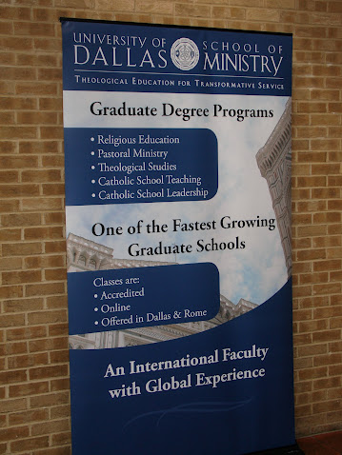
Andrew Hill, J.D. Teaching/Academic Affairs
Adjunct Instructor, Law & Ethics School of Ministry University of Dallas, Irving, Texas 2006 - 2010
Adjunct Instructor, Philosophy Humanities Division Tarrant County College, Fort Worth, Texas 2006 - 2010
Senior Lecturer, Law & Ethics Graduate School St. Mary's University, San Antonio, Texas 2003 - 2006
Lecturer, Law & Ethics Graduate School St. Mary's University, San Antonio, Texas 1998 - 2003

Slide 14
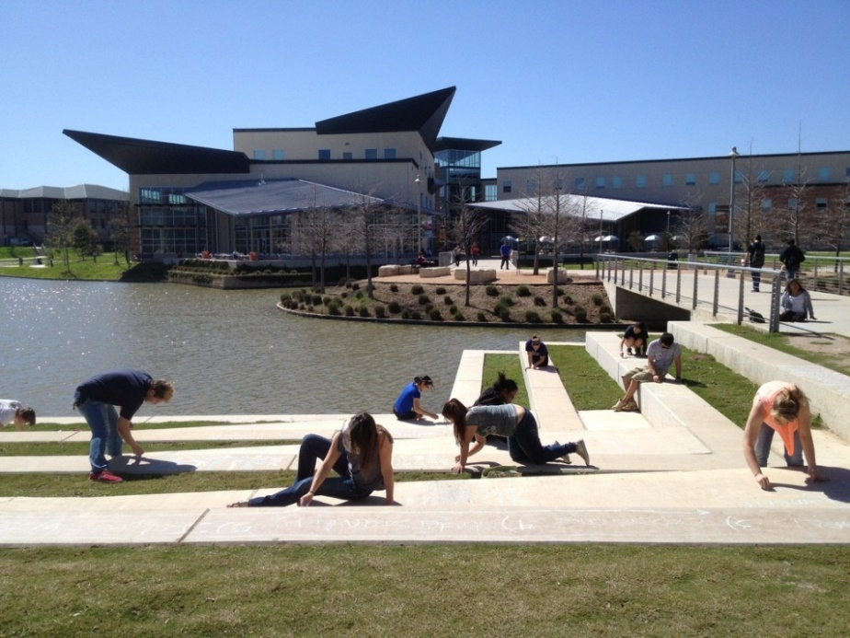
Andrew Hill, J.D. Teaching/Academic Affairs
Instructor, Philosophy & Ethics Humanities Division Northwest Vista College, San Antonio, Texas 2011 - 2013
Adjunct Instructor, Law & Ethics School of Ministry University of Dallas, Irving, Texas 2006 - 2010
Adjunct Instructor, Philosophy Humanities Division Tarrant County College, Fort Worth, Texas 2006 - 2010
Senior Lecturer, Law & Ethics Graduate School St. Mary's University, San Antonio, Texas 2003 - 2006
Lecturer, Law & Ethics Graduate School St. Mary's University, San Antonio, Texas 1998 - 2003

Slide 15
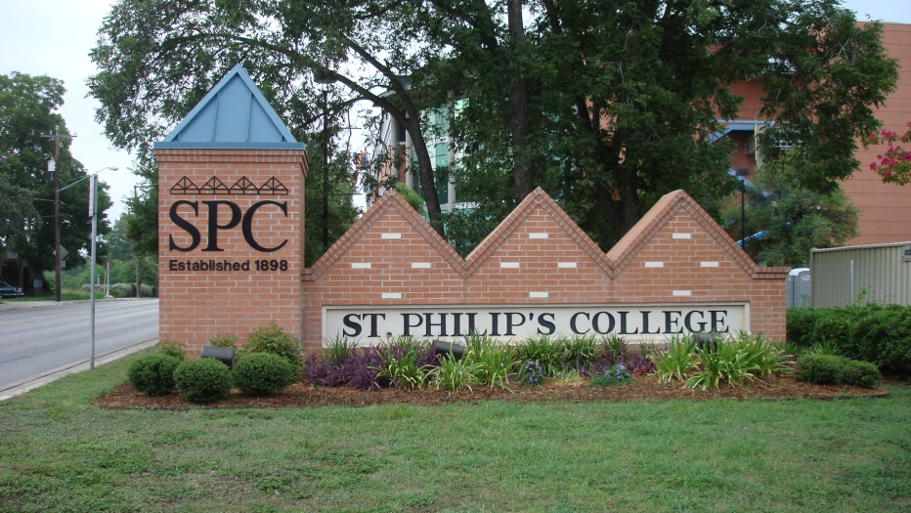
Andrew Hill, J.D. Teaching/Academic Affairs
Assistant Professor, Philosophy & Ethics Arts & Sciences Division St. Philip’s College, San Antonio, Texas 2013 - 2019
Instructor, Philosophy & Ethics Humanities Division Northwest Vista College, San Antonio, Texas 2011 - 2013
Adjunct Instructor, Law & Ethics School of Ministry University of Dallas, Irving, Texas 2006 - 2010
Adjunct Instructor, Philosophy Humanities Division Tarrant County College, Fort Worth, Texas 2006 - 2010
Senior Lecturer, Law & Ethics Graduate School St. Mary's University, San Antonio, Texas 2003 - 2006
Lecturer, Law & Ethics Graduate School St. Mary's University, San Antonio, Texas 1998 - 2003

Slide 16
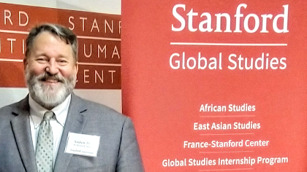
Andrew Hill, J.D. Teaching/Academic Affairs
Associate Professor, Philosophy & Ethics Arts & Sciences Division St. Philip’s College, San Antonio, Texas 2019 - Present
Assistant Professor, Philosophy & Ethics Arts & Sciences Division St. Philip’s College, San Antonio, Texas 2013 - 2019
Instructor, Philosophy & Ethics Humanities Division Northwest Vista College, San Antonio, Texas 2011 - 2013
Adjunct Instructor, Law & Ethics School of Ministry University of Dallas, Irving, Texas 2006 - 2010
Adjunct Instructor, Philosophy Humanities Division Tarrant County College, Fort Worth, Texas 2006 - 2010
Senior Lecturer, Law & Ethics Graduate School St. Mary's University, San Antonio, Texas 2003 - 2006
Lecturer, Law & Ethics Graduate School St. Mary's University, San Antonio, Texas 1998 - 2003
Associate Professor
St. Philip’s College
Faculty Fellow
Stanford University
AY 2018 - 2019

Slide 17
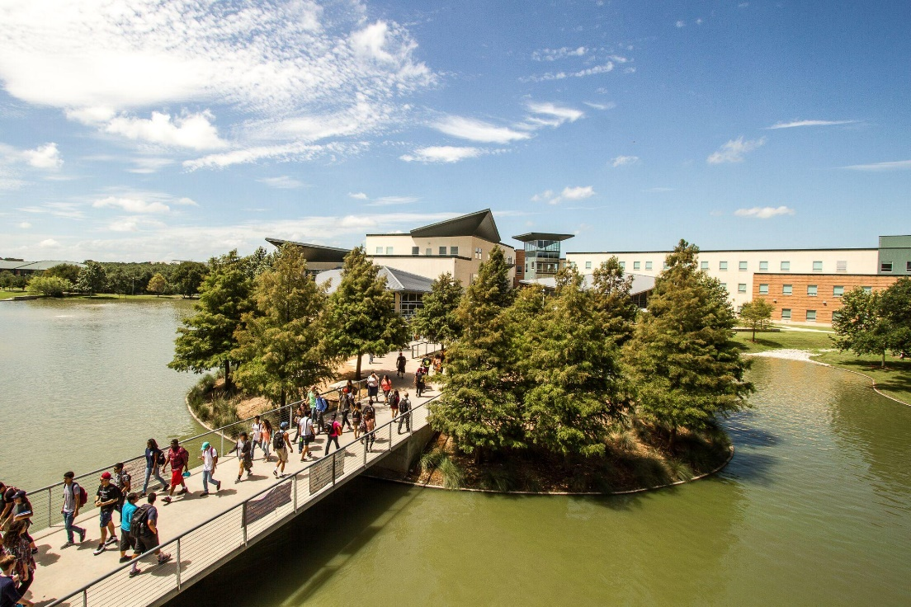
Today, I teach philosophy and ethics at St. Philip’s College, and work with our International and Study Abroad programs.
• 2012 Service Award to the International Education Committee
from Northwest Vista College

Slide 18
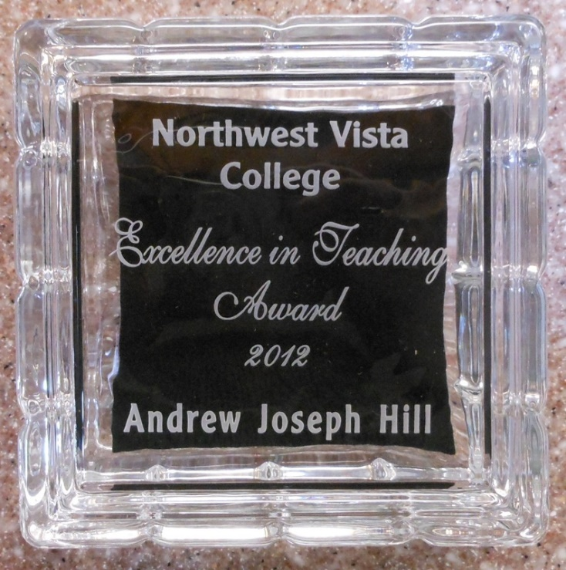
Today, I teach philosophy and ethics at St. Philip’s College, and work with our International and Study Abroad programs.
• 2012 Excellence in Teaching Award
from Northwest Vista College
• 2012 Service Award to the International Education Committee
from Northwest Vista College

Slide 19
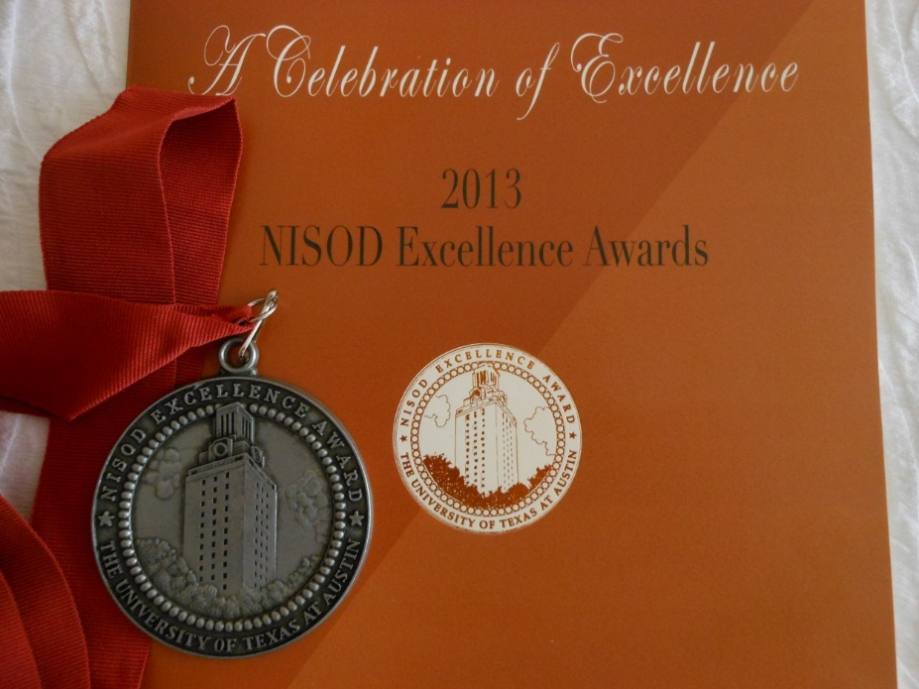
Today, I teach philosophy and ethics at St. Philip’s College, and work with our International and Study Abroad programs.
• 2013 NISOD Excellence Award for Teaching
from the University of Texas at Austin
• 2012 Excellence in Teaching Award
from Northwest Vista College
• 2012 Service Award to the International Education Committee
from Northwest Vista College

Slide 20
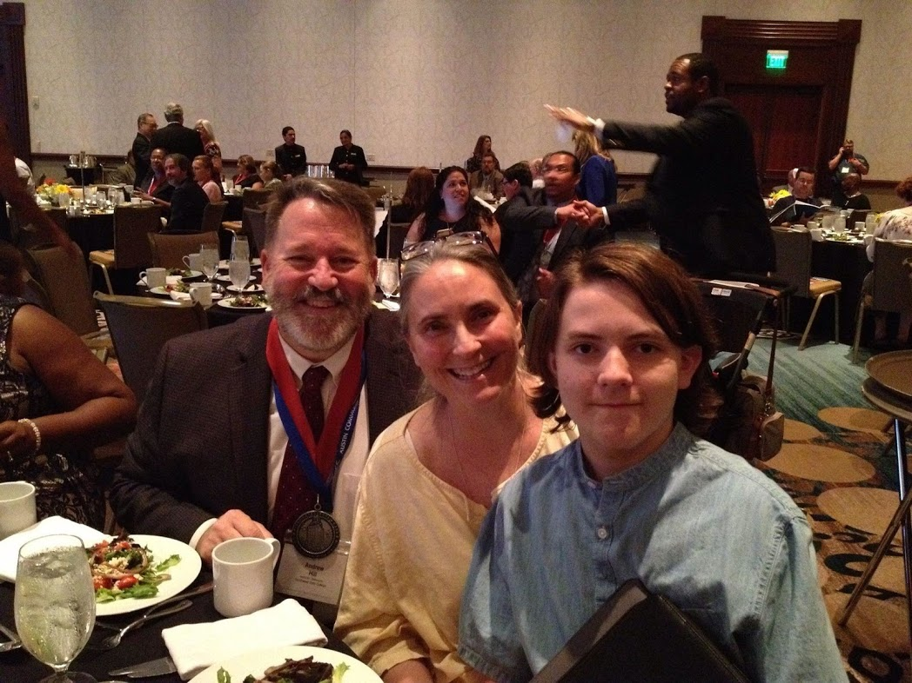
Today, I teach philosophy and ethics at St. Philip’s College, and work with our International and Study Abroad programs.
• 2018 NISOD Excellence Award for Teaching
from the University of Texas at Austin
• 2013 NISOD Excellence Award for Teaching
from the University of Texas at Austin
• 2012 Excellence in Teaching Award
from Northwest Vista College
• 2012 Service Award to the International Education Committee
from Northwest Vista College

Slide 21
I have led teams that have received significant grants:
• 2011 Lilly Fellows Program in Humanities and the Arts
for the Corrymeela Peace Centre and Aquinas College

Slide 22
I have led teams that have received significant grants:
• 2013 United States Institute of Peace
for Northwest Vista College
• 2011 Lilly Fellows Program in Humanities and the Arts
for the Corrymeela Peace Centre and Aquinas College

Slide 23
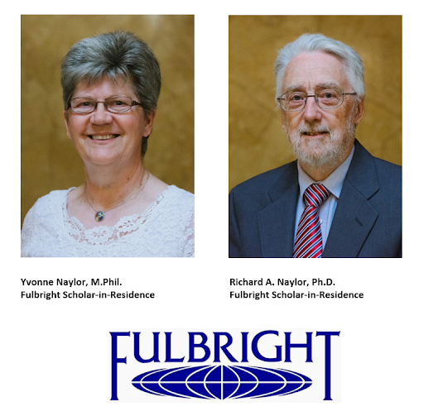
I have led teams that have received significant grants:
• 2015 Fulbright Scholar-in-Residence Grant
for St. Philip’s College
• 2013 United States Institute of Peace
for Northwest Vista College
• 2011 Lilly Fellows Program in Humanities and the Arts
for the Corrymeela Peace Centre and Aquinas College

Slide 24
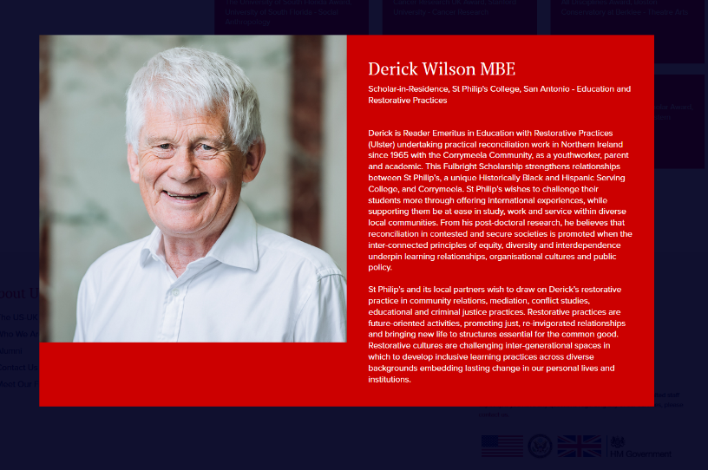
I have led teams that have received significant grants:
• 2017 Fulbright Scholar-in-Residence Grant
for St. Philip’s College
• 2015 Fulbright Scholar-in-Residence Grant
for St. Philip’s College
• 2013 United States Institute of Peace
for Northwest Vista College
• 2011 Lilly Fellows Program in Humanities and the Arts
for the Corrymeela Peace Centre and Aquinas College

Slide 25
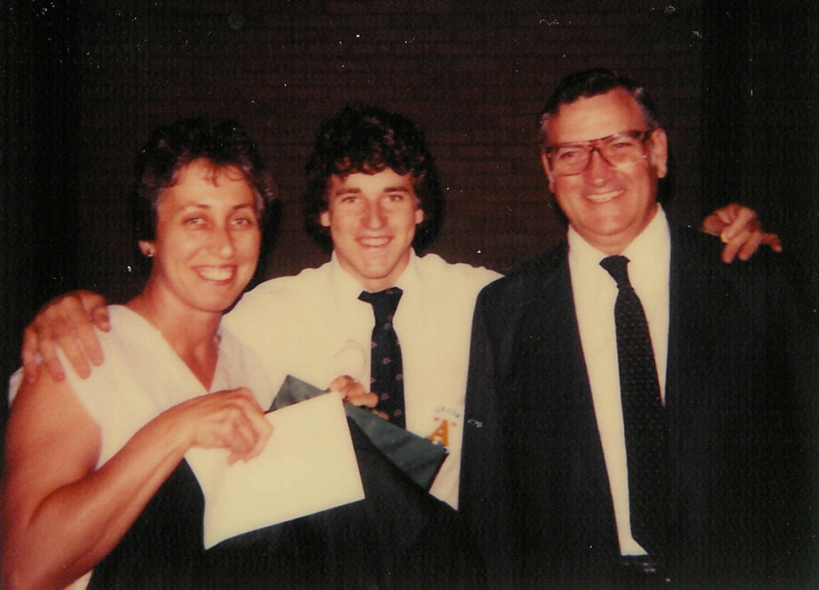
Andrew Hill, J.D. Degrees/Diploma
Diploma Ratio Studiorum Strake Jesuit College Preparatory Houston, Texas 1981

Slide 26
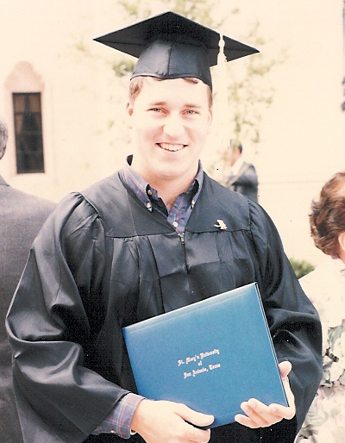
Andrew Hill, J.D. Degrees/Diploma
Bachelor of Arts Philosophy and English St. Mary's University San Antonio, Texas 1986
Diploma Ratio Studiorum Strake Jesuit College Preparatory Houston, Texas 1981

Slide 27
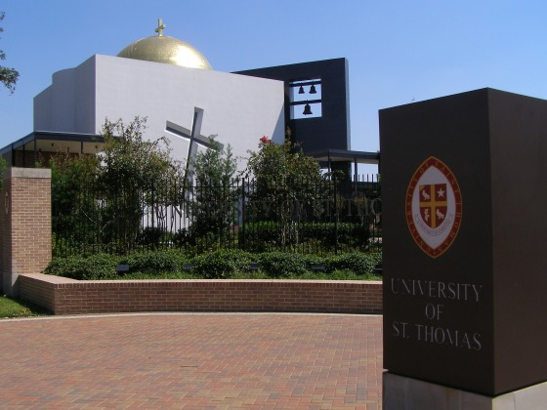
Andrew Hill, J.D. Degrees/Diploma
Master of Arts Philosophy University of St. Thomas Houston, Texas 2007
Bachelor of Arts Philosophy and English St. Mary's University San Antonio, Texas 1986
Diploma Ratio Studiorum Strake Jesuit College Preparatory Houston, Texas 1981

Slide 28
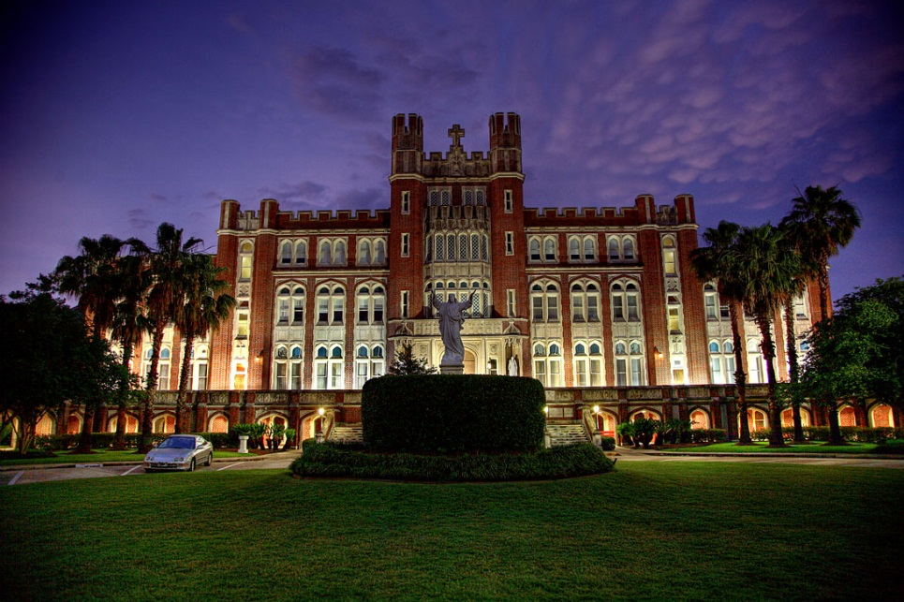
Andrew Hill, J.D. Degrees/Diploma
Doctor of Jurisprudence School of Law Loyola University New Orleans, Louisiana 1998
Master of Arts Philosophy University of St. Thomas Houston, Texas 2007
Bachelor of Arts Philosophy and English St. Mary's University San Antonio, Texas 1986
Diploma Ratio Studiorum Strake Jesuit College Preparatory Houston, Texas 1981

Slide 29
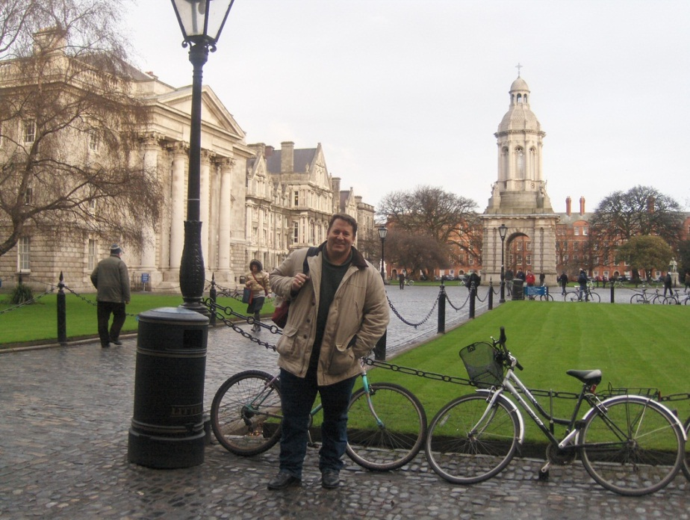
Andrew Hill, J.D. Degrees/Diploma
Doctor of Philosophy Irish School of Ecumenics Trinity College Dublin Dublin, Ireland Degree in Progress
Doctor of Jurisprudence School of Law Loyola University New Orleans, Louisiana 1998
Master of Arts Philosophy University of St. Thomas Houston, Texas 2007
Bachelor of Arts Philosophy and English St. Mary's University San Antonio, Texas 1986
Diploma Ratio Studiorum Strake Jesuit College Preparatory Houston, Texas 1981

Slide 30
I have lived, worked, studied and taught overseas. As part of my studies at Trinity College Dublin, I completed a study abroad program in The Hague, Netherlands, and I spent a year in residence at the Corrymeela Peace and Reconciliation Centre in Ballycastle, Northern Ireland (2010 – 2011).– 2011).

Slide 31
Andrew Hill, J.D. Administrative/
Student Affairs
Andrew Hill, J.D.
Teaching/
Academic Affairs
Andrew Hill, J.D.
Degrees/Diploma

Slide 32
Andrew Hill, J.D.
Andrew Hill, J.D. Administrative/Student Affairs
Andrew Hill, J.D.
Teaching/Academic Affairs
Andrew Hill, J.D.
Degrees/Diploma

Slide 33
Andrew Hill, J.D.
Associate Professor of Philosophy
St. Philip’s College
San Antonio, Texas

